Slide 1

Child Life Playroom Training

Slide 2
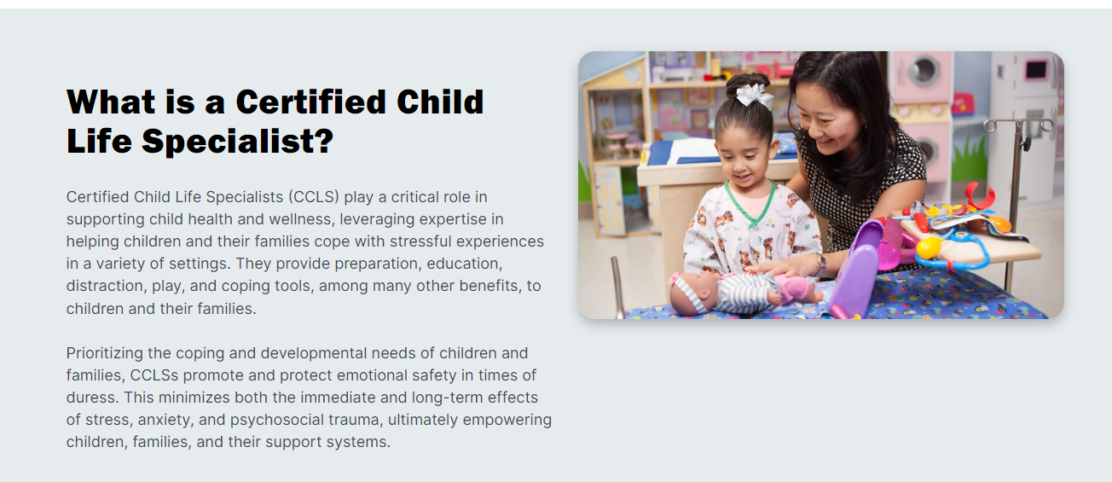
What is a Child Life Specialist?

Slide 3
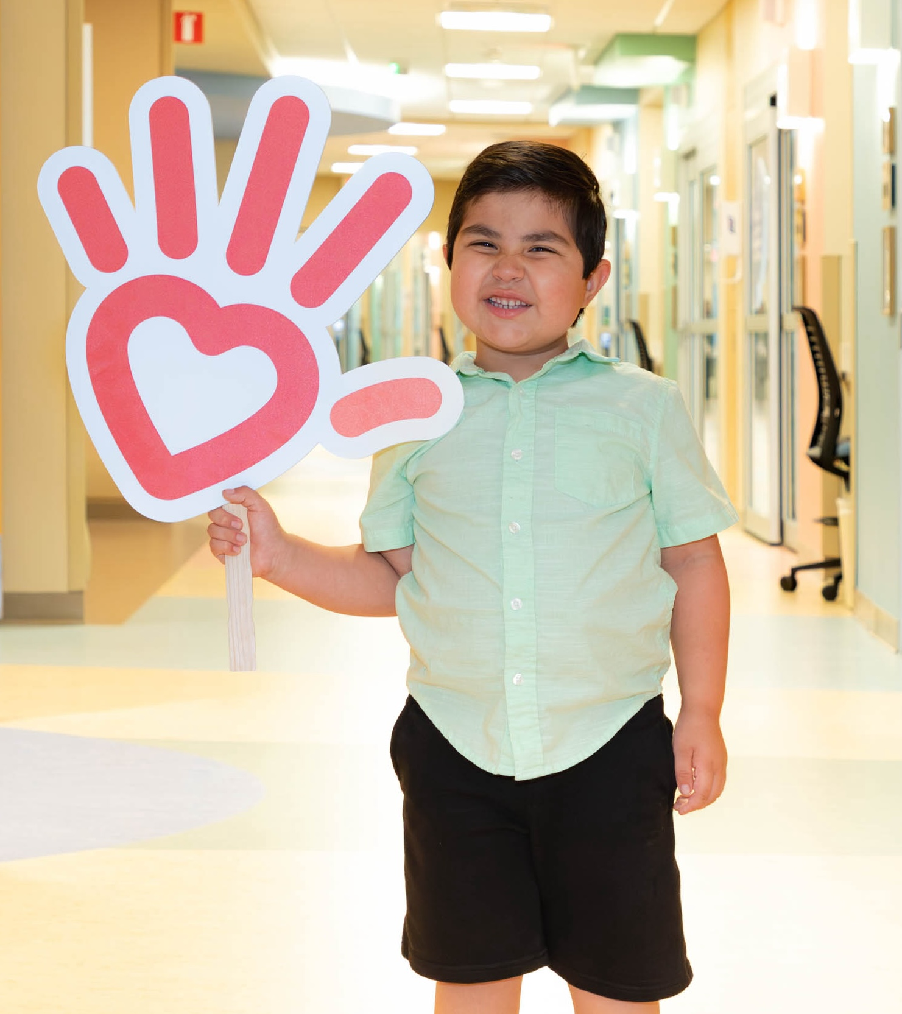
What is a Child Life Assistant?
At Phoenix Children’s Child Life Assistants are the primary resource for volunteers. They run the Playrooms and help train new volunteers.
Child Life Assistants work with Child Life Specialists to provide a caring and comfortable hospital stay.
Child Life Assistants create medical play opportunities to “normalize” medical equipment.
Many things happen in the playroom: fun, arts and crafts, playtime, and resources (books, games, movies, videos). Also: TOY CLEANING!!
Each floor has a different patient population and slight variations. This training is intended to introduce you to these differences.

Slide 4
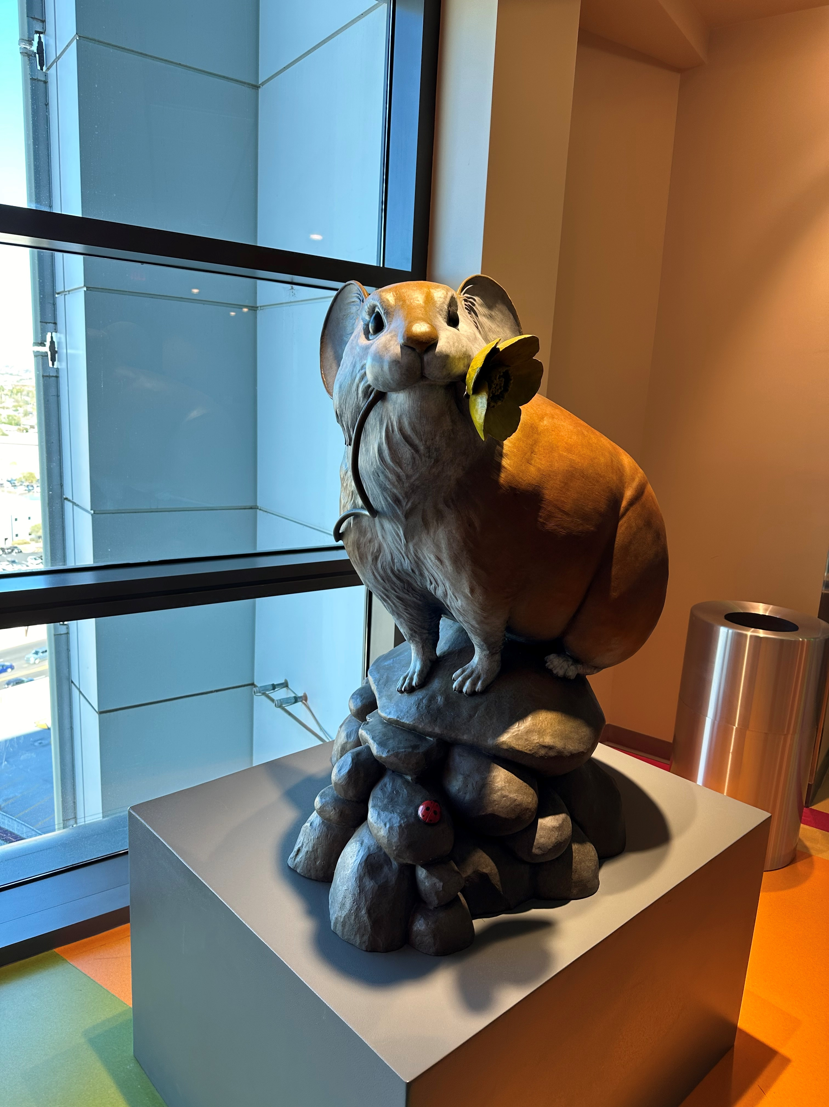
10th Floor Playroom
10th Floor: Hepatology* GI* Endocrine* CF* Infectious Respiratory* Eating Disorders*SI*
Special Precautions:
  Cystic Fibrosis Patients: are always on Isolation in their rooms for their own protection.
  CF Walks: Yellow gown and mask and gloves. Can go to the outdoor patio with Nurse approval.
  SI Patients: placed in safety rooms and always have a sitter.
  Single Use Isolation Playroom: Can be reserved and used with patients requiring isolation.

Slide 5
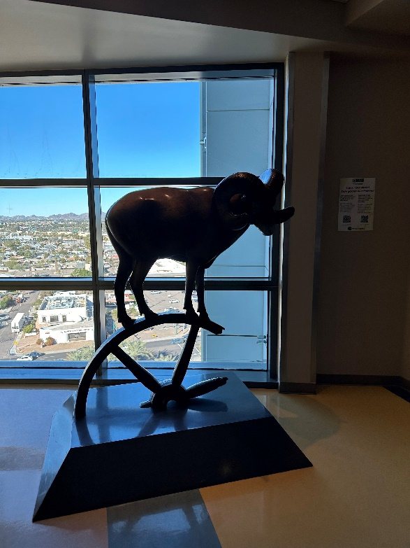
9th Floor Playroom
9th Floor: Orthopedic surgery* Trauma* Cardiac Monitoring* Observation
Trauma: SNAT & NAT Trauma sensitive patients.
Don’t ask questions. If a patient talks about sensitive info, listen, and pass info to Child Life.
Quick Turnaround--- patients in and out quickly.
Lots of Contact/Droplet precautions: check with the nurse before you enter a patient room and make sure you are using correct PPE.

Slide 6
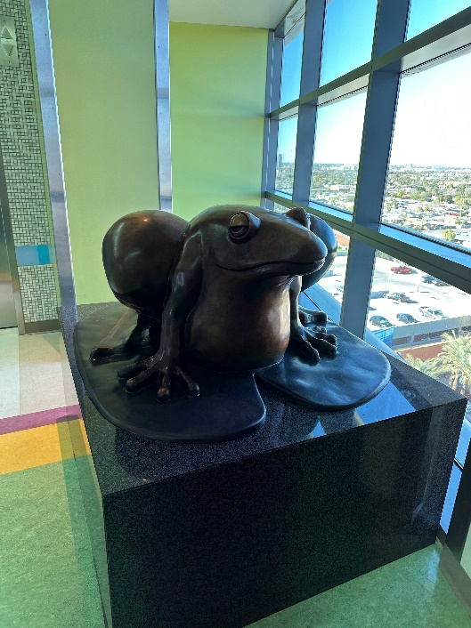
8th Floor Playroom
8th Floor: Nephrology* Neurosurgery* Renal* Transplant* PEMU
Special Programs:
  EEG/PEMU: Patients have leads on their heads and cameras in their rooms to video seizures. These patients can’t go to the Playroom.

Slide 7
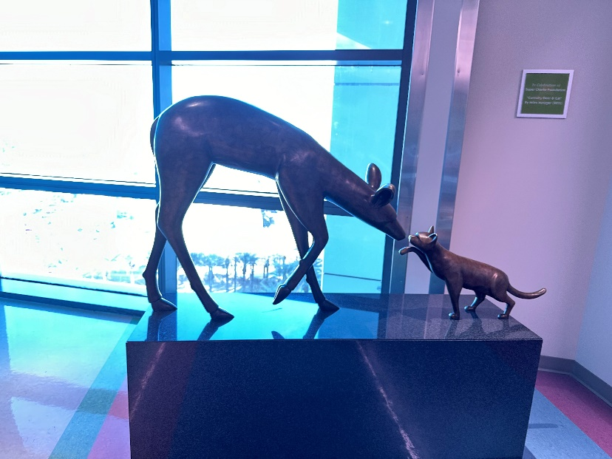
7th Floor Playroom
7 East has the HIP and BMT units
7 East has highly immunocompromised patients.
BMT Single Use playroom: patients can go with their parents. Must be deep cleaned.
Patients in the BMT area get new toys. Check with Child Life.
Soiled toys: Go in a bag in the Playroom. Wear gloves and clean in the Playroom.
The CLA will teach you about tech delivery(movies/video games)
7th Floor: Hematology* Oncology* Bone Marrow Transplant*

Slide 8
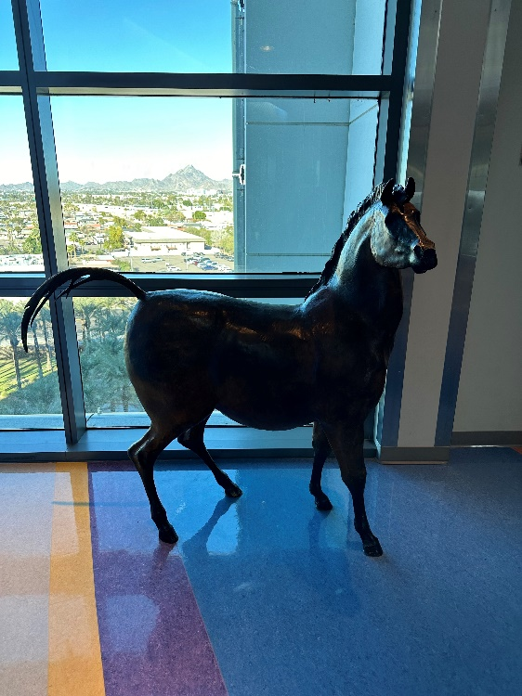
6th floor (No Playroom)
6th Floor: East PICU: Pediatric Intensive Care Unit* West: Respiratory*
Bedside visits: primarily.
HUC desk: Have them vocera Child Life for Main 6.
Process to clean toys and store them.
PICU on the East side. Surgeries can happen on the unit. If something medical is happening, stay out of the way.

Slide 9
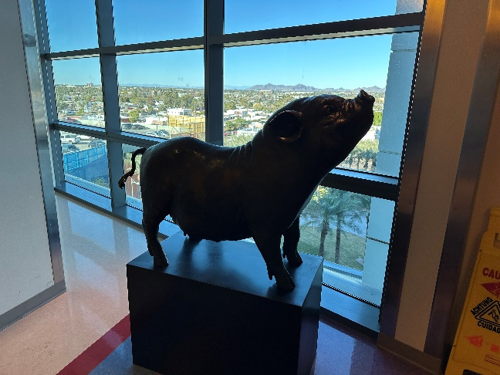
5th Floor Playroom
5th Floor: CVICU: Cardiovascular Intensive Care Unit*
CVICU: Many special precautions
Sternal Precautions- do not lift up under arms--- must be scooped
Single Ventricle/Shunt Dependent Precautions– babies cannot get upset or cry
Please refer to the expanded CVICU training videos.
When holding patients, please wear gloves and use a blanket barrier between you and the patient even if the signage doesn’t tell you to.

Slide 10

East Building: 4th Floor Playroom
Currently closed. Patients can be on the 2nd, 3rd, 4th floors or in D, E and F-Pods
Vocera Omar Almanza for toy needs for patients.
Med-Surgical overflow for main building.
Check in on the units for toy cleaning, toy & blanket delivery, hand hygiene audits or patient care.

Slide 11

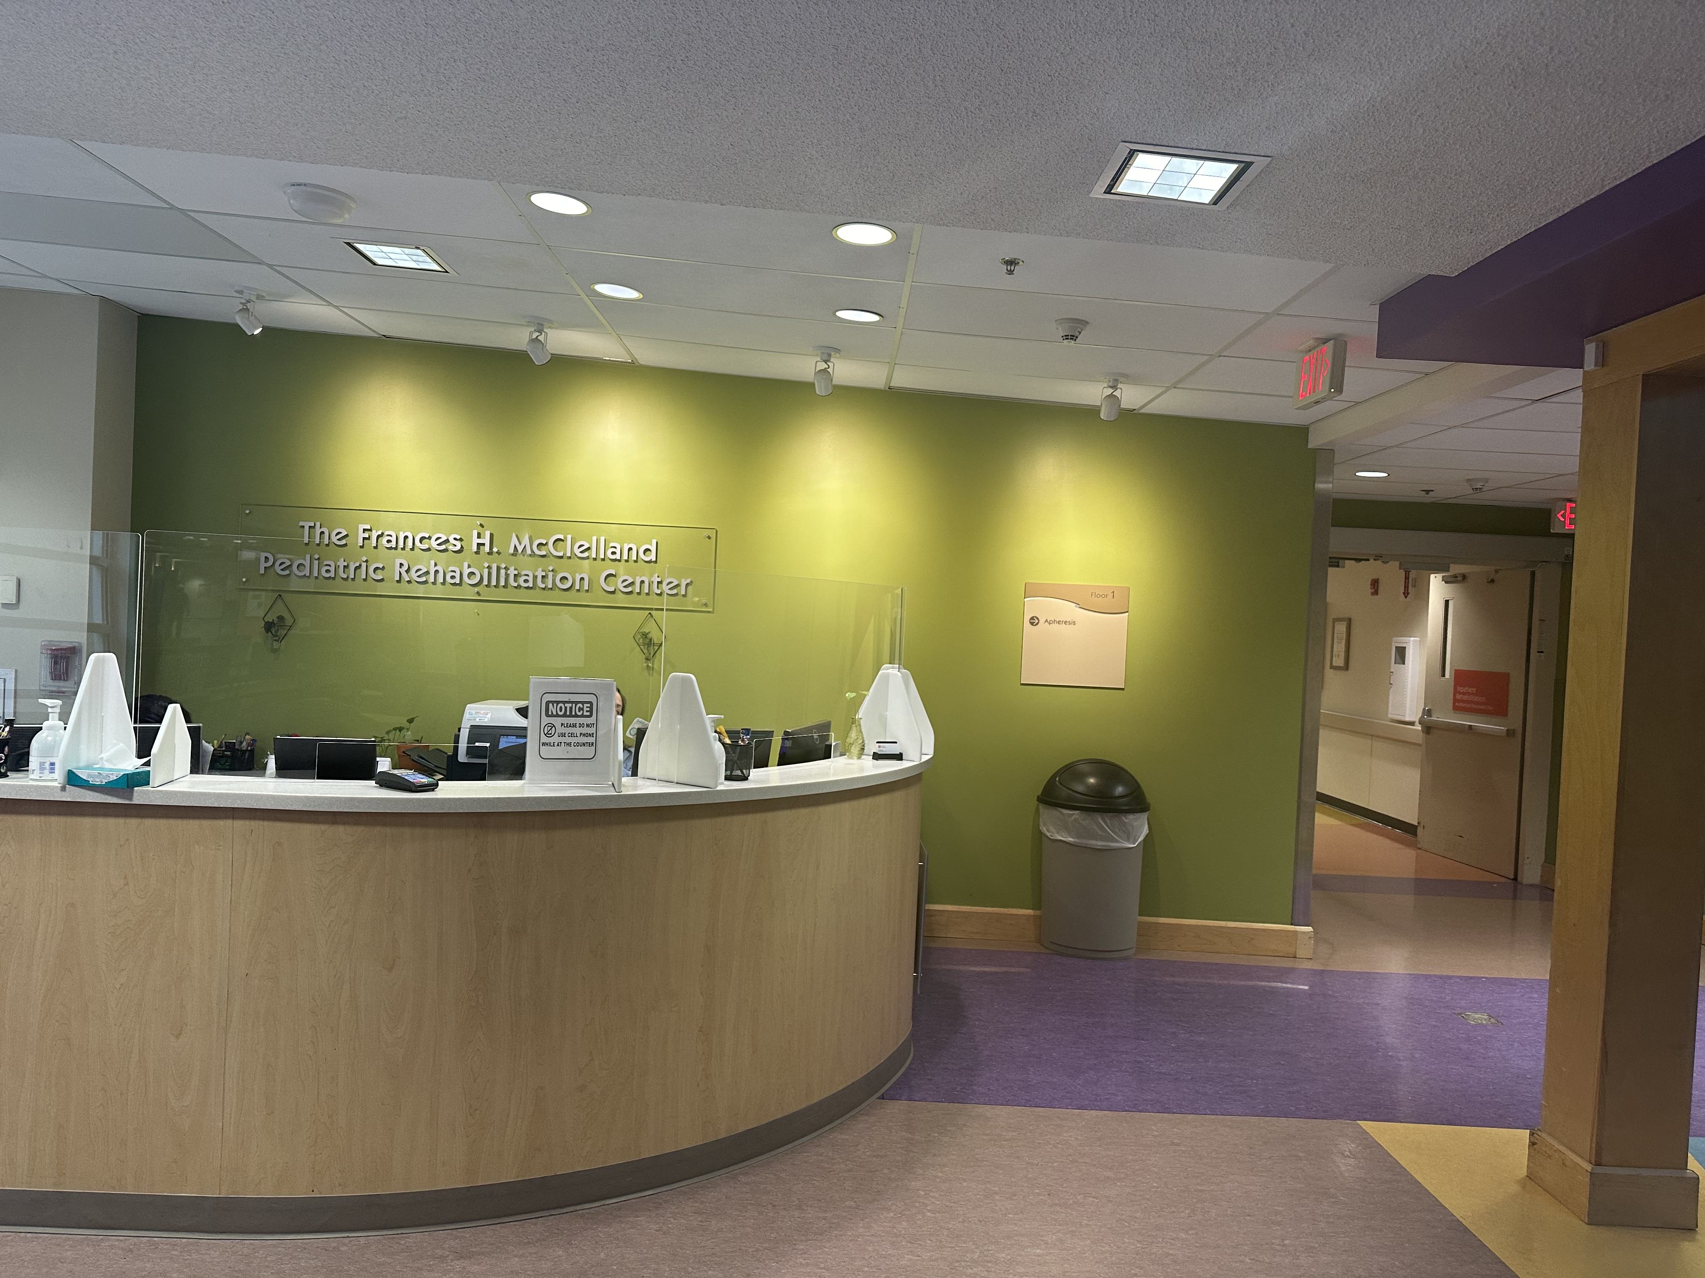
East Building: Rehab
12 In-patient rooms.
No Playroom although there is a storage area for toys.
Break families where you can (Hi, I can sit with your child for 15-20 minutes so you can take a break, get a coffee, grab some lunch).
Check in with In-Patient and Out-Patient Rehab for Toy cleaning needs.

Slide 12

Child Life Zone
The Child Life Zone is known as “The Happiest Place in the Hospital.” Through meaningful interactions and therapeutic activities with a personalized focus, the Zone is all about the experience. Zone programming offers a variety of innovative and engaging opportunities.
The state-of-the-art Zone space features 3,800 square feet of fun! In the Zone you’ll find:
Arcade Games
Daily Crafts
Gaming Consoles
Jukebox
Photo Booth
3D and Laser Printing
The Zone is also home to CLZTV, the hospital’s own interactive broadcast studio. Patients and families look forward to being part of the action in the studio or from their rooms. The Child Life Zone Network, established by Garth Brooks’ Teammates for Kids Foundation, consists of 14 Zones in hospitals throughout North America.

Slide 13
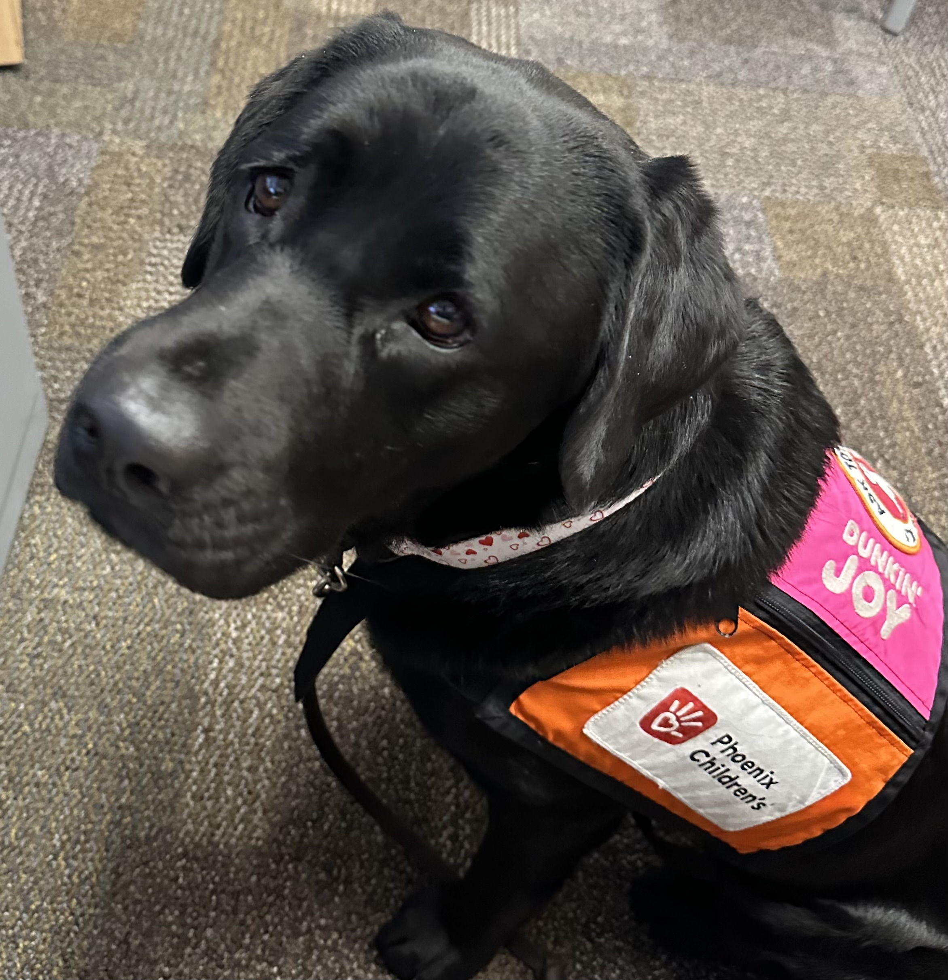
Animal Assisted Therapy
The AAT Program includes both volunteer therapy animal teams and full-time employed facility dog teams. Our volunteer teams visit patients, families, and staff at events and at the bedside, improving their mood and helping them through tough days. Current therapy animals are pictured here.
Our facility dog teams work with staff to help patients meet treatment goals from physical therapy sessions to preparing for an upcoming surgery or procedure. The facility dogs live and work with their handlers and are specially trained to work full-time in the hospital setting. Lisa is a Rehabilitation Facility Dog Handler, and she works with Checkers.
Patient bedside visits are requested by the patient's doctors, nurses, occupational and physical therapists or child life specialists. We work with the patient's care team to create a session that works toward the patient's treatment goals.

Slide 14

Toy Cleaning
Play and school equipment and toys are routinely cleaned and disinfected to reduce the risk of transmission of infection between children.
You clean toys with:
  Oxivir wipes. Leave wet for 1 minutes. If toy can be mouthed, rinse off with water and dry.
  Germicidal other than Oxivir, toys must be rinsed with water.
  Items that cannot be cleaned should go home with patients or thrown away.
  Red Tape: Use bleach to clean and leave wet for 3 mins before rinsing.

Slide 15

Toy cleaning: Single Use Playroom
Single Use Playrooms are:
Used by 1 patient and family at a time as assessed by Child Life.
Being cared for using Isolation Precautions who cannot visit multi-patient Playroom.
Preference given to patients experiencing a hospitalization longer than 5 days.
Patients use playroom when being supervised by parent, PCH staff or volunteer.
Isolation precautions are maintained when patient is traveling to and from single-use rooms.
Siblings/child guests must be supervised by an adult over the age 18.
During transport to and from single use playrooms:
Contact precautions: Patients wear gown, glove and mask. Parents wear an adult patient gown and wash hands. Place sheet or blanket over chair/wagon. Don’t touch things along the way and no public restrooms. PPE can be removed while in the playroom but new PPE must be used to return to the room.
Droplet precautions: Before leaving the room, patients must mask or mask equivalent. Patients les than 3 “tent” using blanket or sheet. Patients age, 3-12 use child mask. Patient ages over 12 use an adult mask.
Airborne Precautions: Cannot use single use playrooms.
Contact Precautions Plus: Cannot use single use playrooms

Slide 16
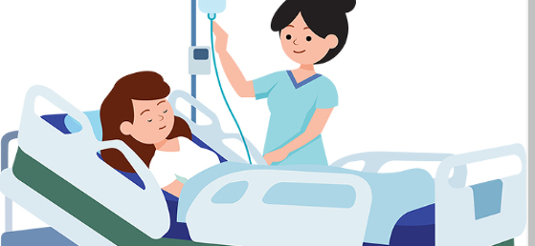
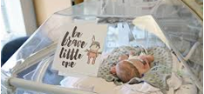
Cribs and Beds
Always get help from staff (Child Life or Nursing) if you transport patients to and from beds/cribs.
Make sure railings are up and cribs are secure before leaving a patient.
Let the nurse know you are leaving.

Slide 17
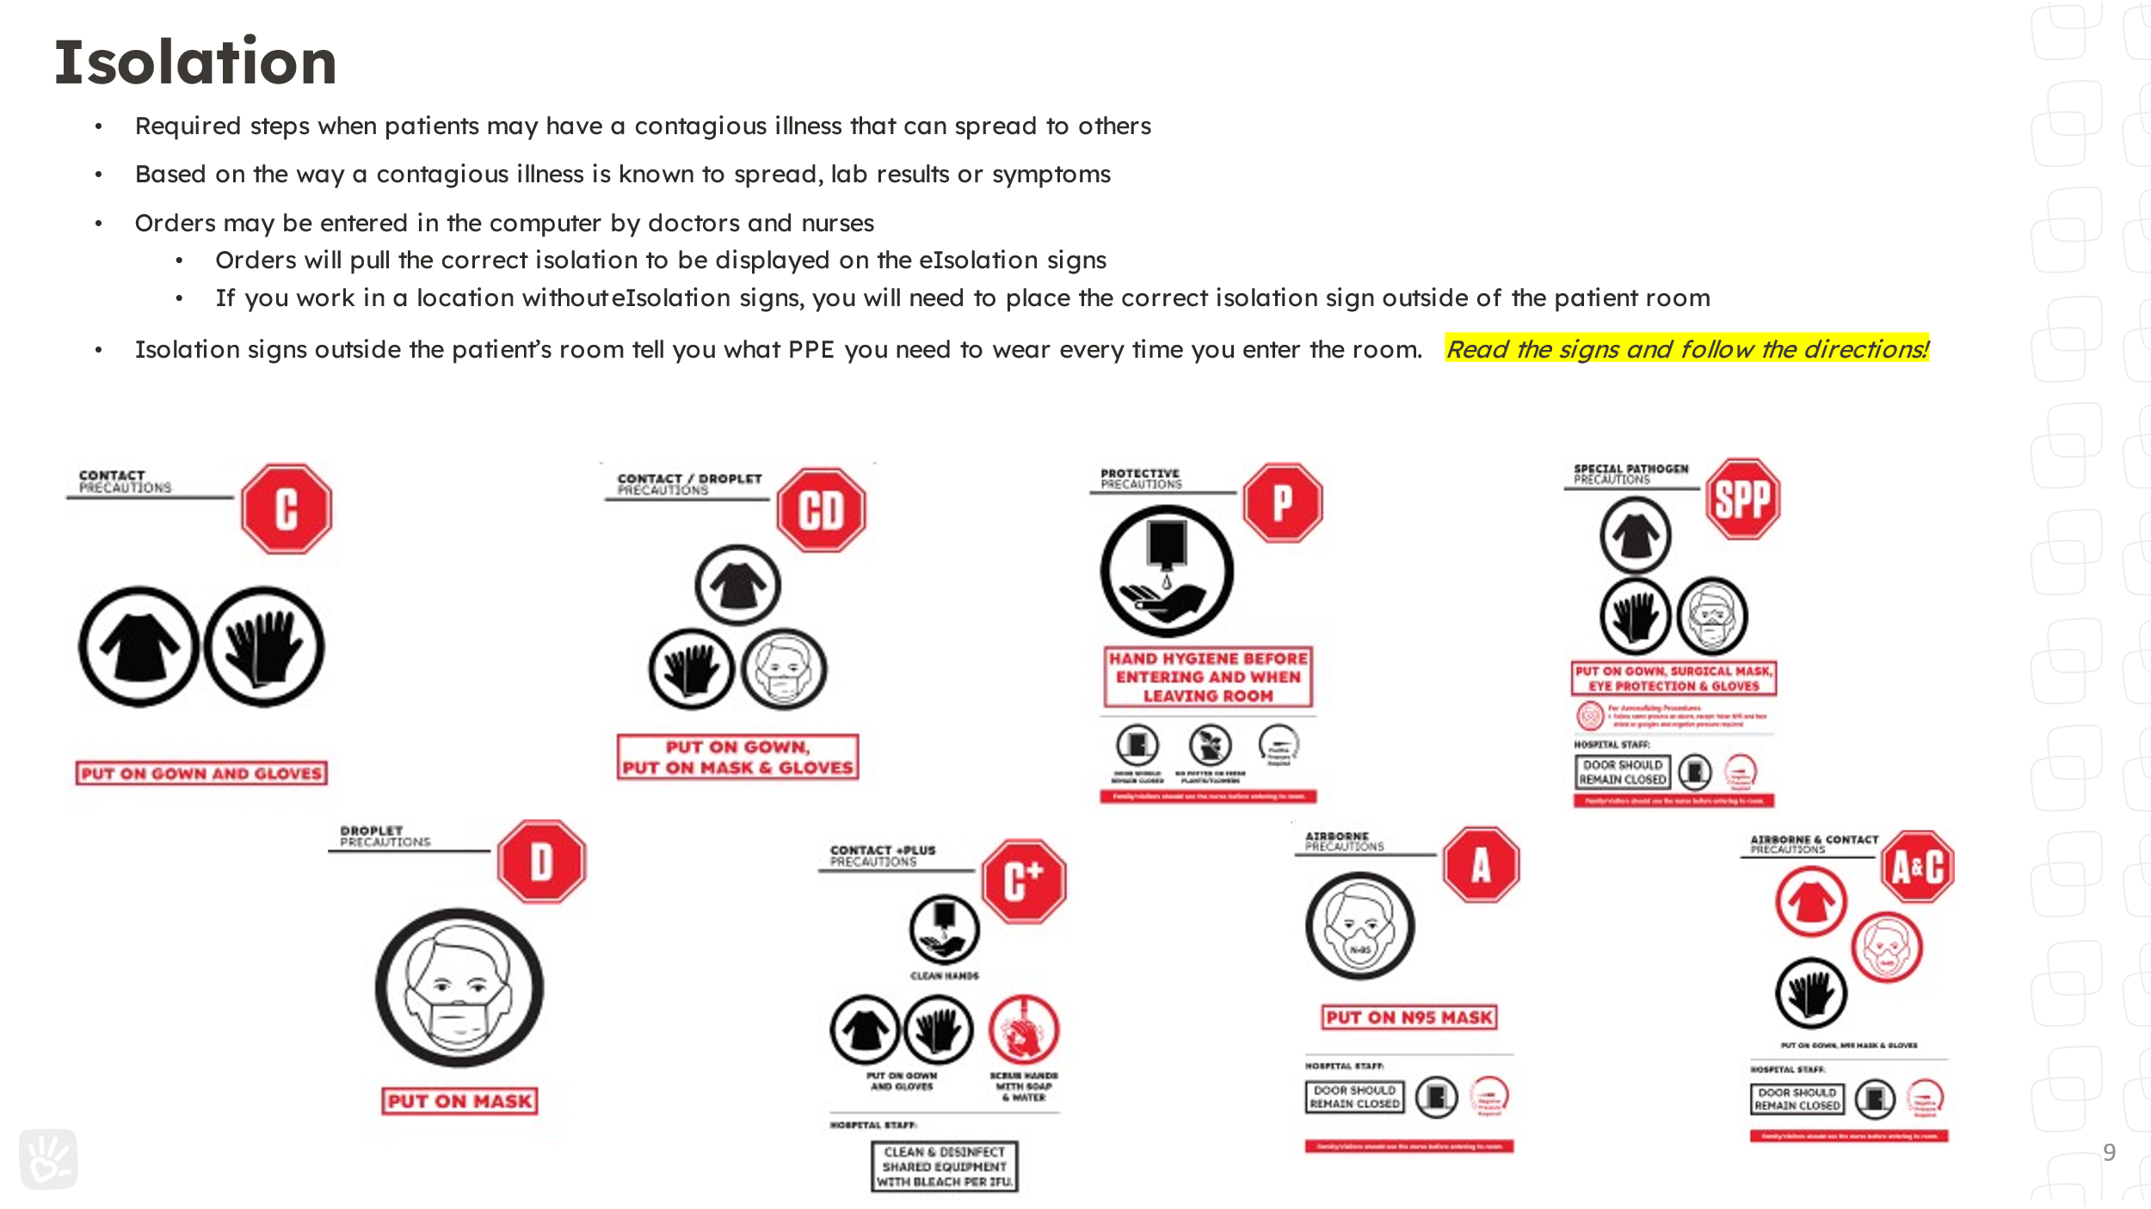
Bedside Visits
Know the Isolation Precaution Signs--- follow them. No volunteers allowed in Special Pathogens Room!!!!!
Everyone in the room must be wearing a mask before you can enter.
If PPE is required, follow signage and put it on before entering the room. Dispose of it in the room.
Equipment: IV pumps, feeding machine, Pulse oximeter, monitors, PD, HD etc
Special Considerations:
  PEMU
  CVICU
  PICU
  Trach

Slide 18

PPE: Personal Protective Equipment
You will be taught proper use of PPE.
Please ALWAYS read the signs before you go into a room.
NEVER go into a Special Pathogens or Airborne precautions room.

Slide 19
Calling off a shift
Make
Please make sure you give 24 hours notice to call off of a shift
Take
Take yourself off of your shift in Samaritan
Sign up
Sign up for a make up shift. If you cannot find an open shift that works for your schedule, check with your volunteer coordinator

Slide 20
Thank you!

